Slide 1
Online Shopping Intention Prediction
NAVYA

Slide 2
Use Case
Model user behaviour is based on their interaction with an E-commerce websites
Measures which website actions correlate with revenue and sales .
Identify Seasonal trends in buying behaviour

Slide 3
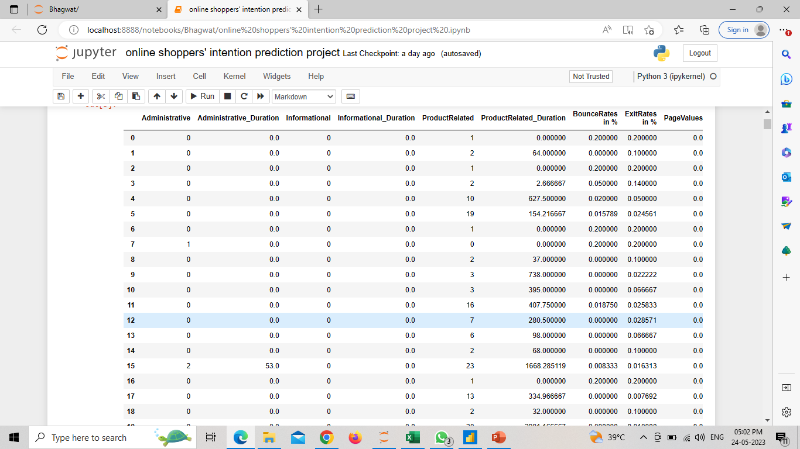
Dataset
Consist of 12330 rows and 18 columns(object=2,int = 7,float = 2,bool = 7)

Slide 4
Data Quality Assesment
No Missing Values
Present outliers
Highly Imbalanced

Slide 5
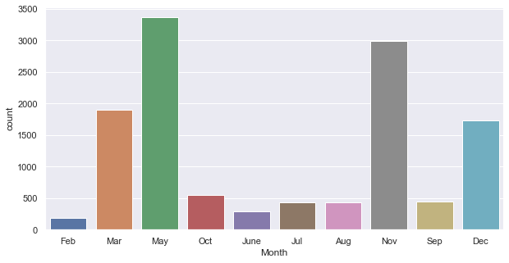
Exploration and Visualization
Above plot shows month wise visit of peoples on the websites or online platforms.
It represents clearly that in the month May , Nov , Mar , Dec .this are the month in which visitors visited highly on the shopping sites /pages.

Slide 6
Outliers Handling
Checking Outliers
Found maximum columns are having outliers .
Need to handle outliers which might impact the accuracy
Handling outliers
Outliers which are present into numerical columns are handled manually .
All the outliers are removed except few columns because they were not distributed normally .

Slide 7
Feature Engineering
Missing values were not handled , no missing values into dataset .
Each numerical values were clipped to remove outliers
Used Encoding Technique , categorical variables were one hot encoded and Boolean variables were label encoded
Variables were not in same scale , used feature scaling technique , used StandardScalar to bring values into same scale

Slide 8
Balancing Dataset
Target Variable ‘Revenue’ was highly imbalanced .
No of True and False were not in equal proportion, to balance into 50-50 % ,
Using oversampling technique ‘RandomOverSampling’ will balances the target variable

Slide 9
Model Selection
Decision tree classification
Random forest classification
Logistic Regression classification
Voting classifier

Slide 10
Results
Method used Accuracy
0 DecissionTree = 0.849124
1 RandomForest_Entropy =0.906452
2 RandomForest_Gini = 0.905013
3 LogisticRegression = 0.857280
4 VotingClassifier = 0.899496

Slide 11
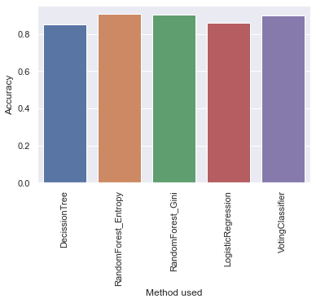
Visualising Result

Slide 12
Thank you

